Slide 1
Project Title （小组成员）
陈意-Chen 杨楚凝-Nora 汪含之-Hanzhi

Slide 2
Translation of mouse motion track
（鼠标运动轨迹的转译）
The collection of mouse tracks, and the spread of it from two to three dimensions, allows us to visualize data about computer usage.
对鼠标运动轨迹的收集，并且把它从二维向三维展开，实现我们对电脑使用情况的数据可视化。

Slide 3
In the following time, my teammates and I will cooperate with each other. Some of us will collect data by using software, and some of us will purchase all the materials needed for a big operation. In addition, we will carry out the preliminary construction as soon as possible, and try to find out the problems in the operation and solve them. 对鼠标轨迹的可视化，它能记录我们一天之中在电脑上的痕迹 ，对电脑的使用程度，以及会记录我们的日常上网的路径，可以体现我们对电脑的依赖使用程度，过度使用电脑的人鼠标路径会非常大的密集，而不怎么用电脑的人黑 色的圆就会非常大，我们觉得非常有趣。

Slide 4
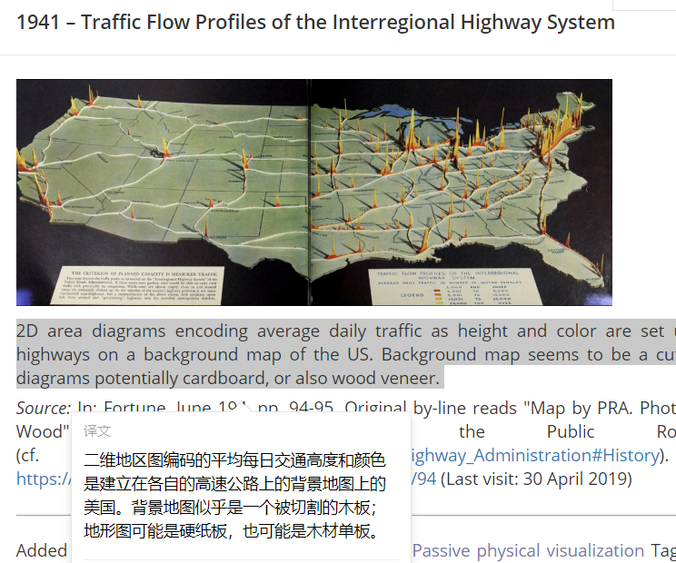
Inspiration
（灵感）
My inspiration comes from this art work, which expresses the road map of the plane in 3D. I think there is a route in the mouse movement, so I also want to express the mouse track in 3D.（我的灵感来自于这个艺术作品，它把平面的路线图通过3D的方式表达出来，我想鼠标运动的过程中也是有路线的，所以也想用3D的方式来表现鼠标轨迹。）

Slide 5
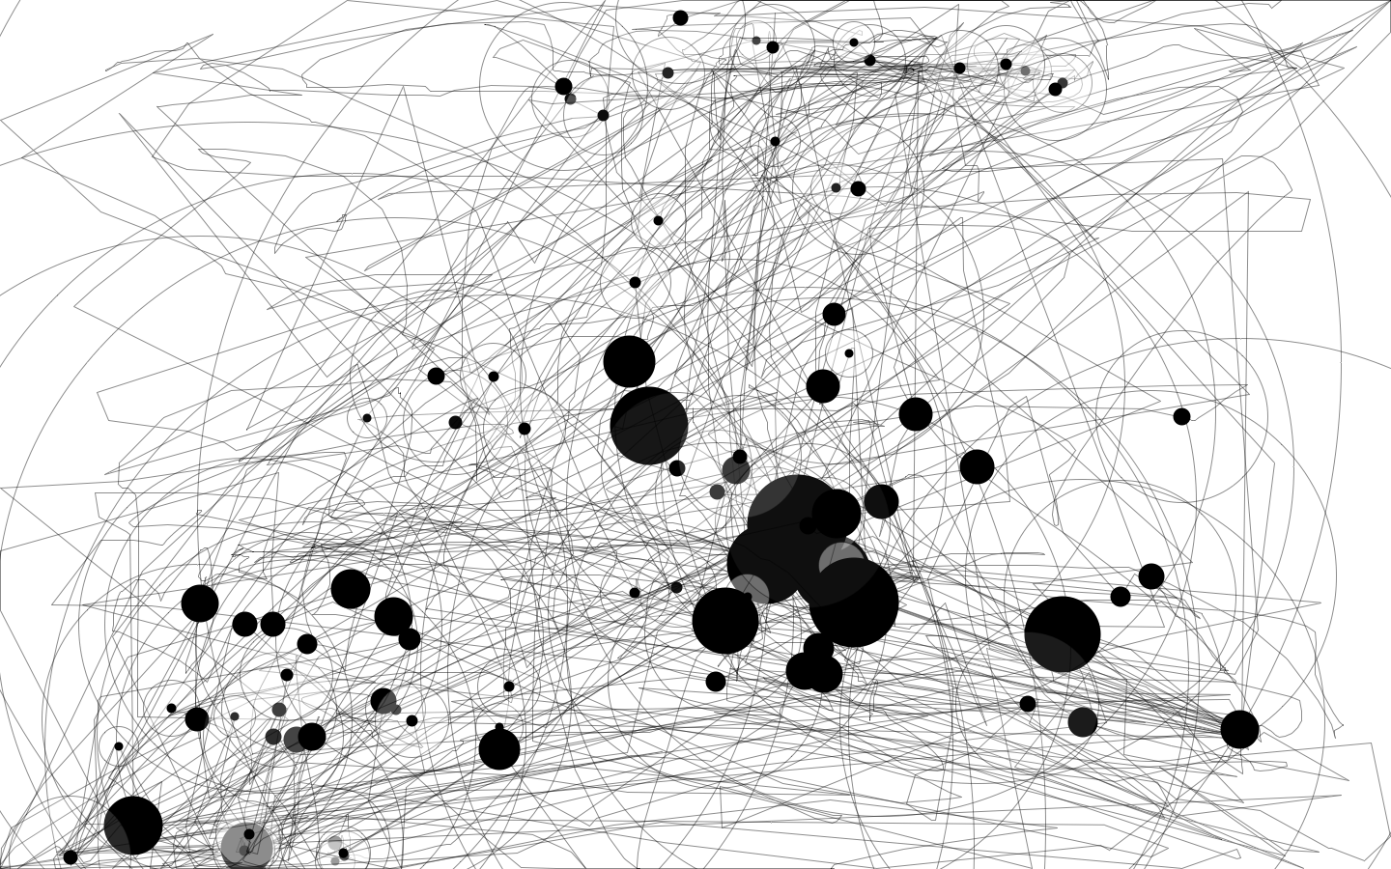
Our data is not a specific number, but a graph, a graph generated by IOgraph, which we will represent in 3D.
If it works, it will be suspended in mid-air.
我们的数据它不是具体的数字，而是一张图，一张由IOgraph（一款鼠标轨迹的记录软件）生成的图，我们会把这张图用3D的方式表现出来。如果顺利的话，它会被挂在半空中。

Slide 6
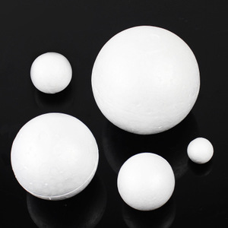
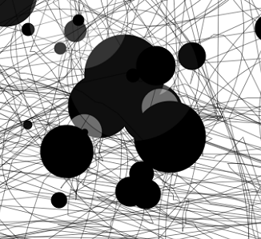
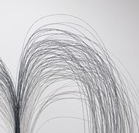
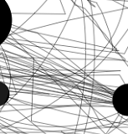
Foam balls represent black spots, and thin wire lines represent trajectories.
用泡沫球代表停留黑点，细的铁丝线代表轨迹。
like this
如下

Slide 7
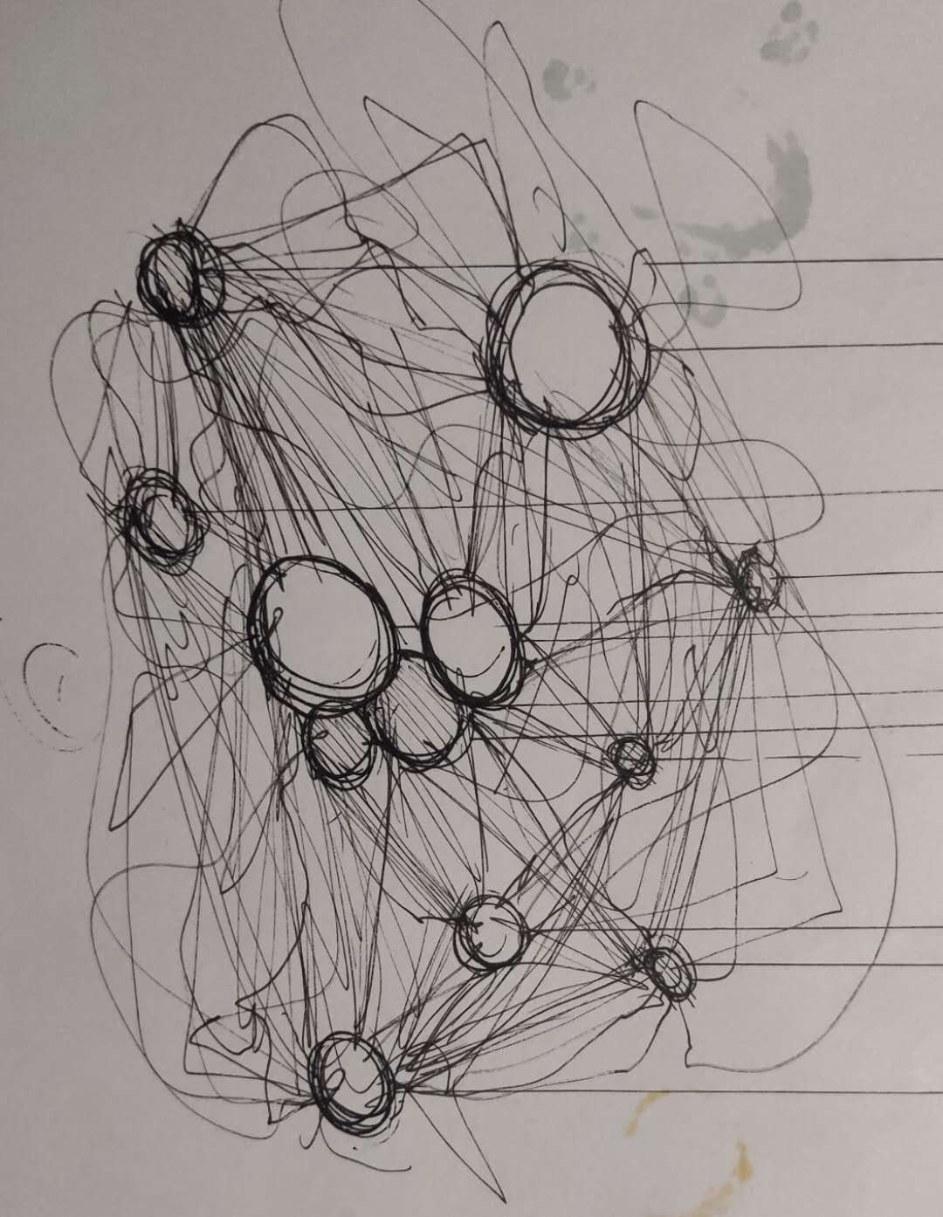
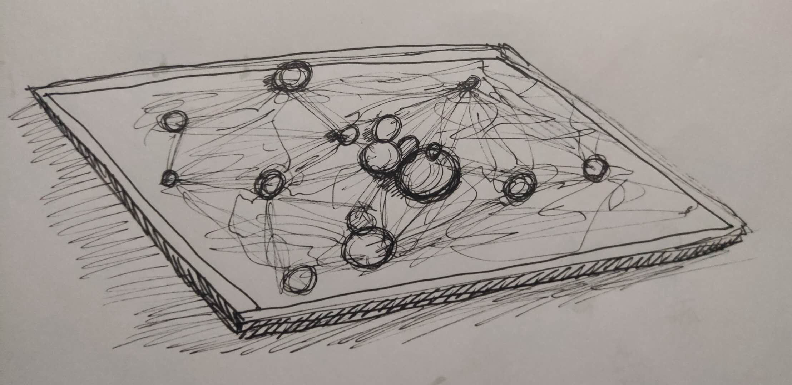
Form Sketches
形成草图
Sketches
plan B

Slide 8
Wednesday: search for test material and collect mouse movement data. 周三：寻找试验材料，收集鼠标运动数据。 Thursday: determine the materials to be used and collect mouse movement data. 周四:确定要用到的材料，收集鼠标运动数据。 Friday: derive sketches and collect mouse movement data. 周五：推导草图，收集鼠标运动数据。 Next Monday: finalize the sketch, start trying to build the model, and collect mouse movement data. 下周一：确定草图，开始试着搭建模型，收集鼠标运动数据。 Next Tuesday: build the model and identify at least four sketches. 下周二；搭建模型，至少确定四张草图。 Next Wednesday: look at the exhibition area to see if the model can be hung in mid-air and change the plan according to the situation. 下周三:看展区，确定模型能否挂在半空，看情况改计划。 Next Thursday and Friday: exhibition arrangement 下周四、周五：布展。

Slide 9
Thank you

